Slide 1

Business Breakfast: How To Run A “Virtual” Business
Thomas Rayner

Slide 2
Abstract
Session Description | Dream of running a business from home? Join the thousands of Canadians who run successful “virtual businesses” with a little help from modern tech. Find out how to look credible, produce professional results, collaborate effectively with partners, vendors and employees—and keep your costs down. Inspired by MicrosoftSavesYouMoney.ca, this presentation will give great tips and advice on how to launch and run your business without breaking the bank. You’ll get a chance to ask a Microsoft small business expert any question you have. And breakfast is on us!

Slide 3

Thomas Rayner
Follow me: @MrThomasRayner, workingsysadmin.com, linkedin.com/in/thomasrayner

Slide 4

We work Anywhere…
By 2016 40% of the workforce will be mobile - Gartner

Slide 5

We work Anytime…
Work
Life
Flexible work is prevalent – rethink your definition of a mobile worker.

Slide 6


WE work On Any device…
By 2015 at least 60% of information workers will interact with content applications
via a mobile device - Gartner

Slide 7




WE Work With More people…
60% of employees report working with 10 or more people on a day-to-day basis.
Half of these employees work with more than 20.
We work with more people on a day-to-day basis today than ever before.
Notes:
KANWAL
Sixty percent of employees report working with 10 or more people on a day-to-day basis (and one-half of these employees report needing to work with more than 20).
The Corporate Executive Board, “Breakthrough Performance in the New Work Environment,” http://www.executiveboard.com/exbd-resources/pdf/executive-guidance/eg2013-annual-final.pdf

Slide 8
5 Ways to RUN A VIRTUAL BUSINESS…
Modern Productivity
Connecting Teams
Great Customer Experiences
Building & Amplifying Your Brand
Outsourcing & Renting

Slide 9
5 Ways to Run A Virtual Business…
Modern Productivity
Connecting Teams
Great Customer Experiences
Building & Amplifying Your Brand
Outsourcing & Renting

Slide 10
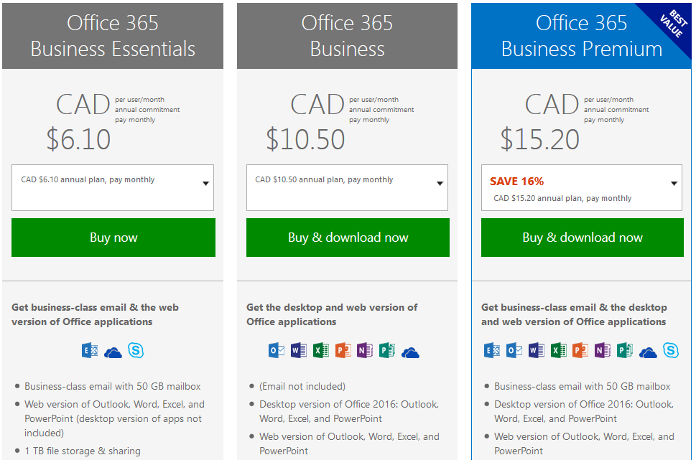
#1. Modern Productivity…
Do you have mail, video conferencing, document storage/sharing and more?
Reduce your license costs by getting everything together in Office 365.

Slide 11
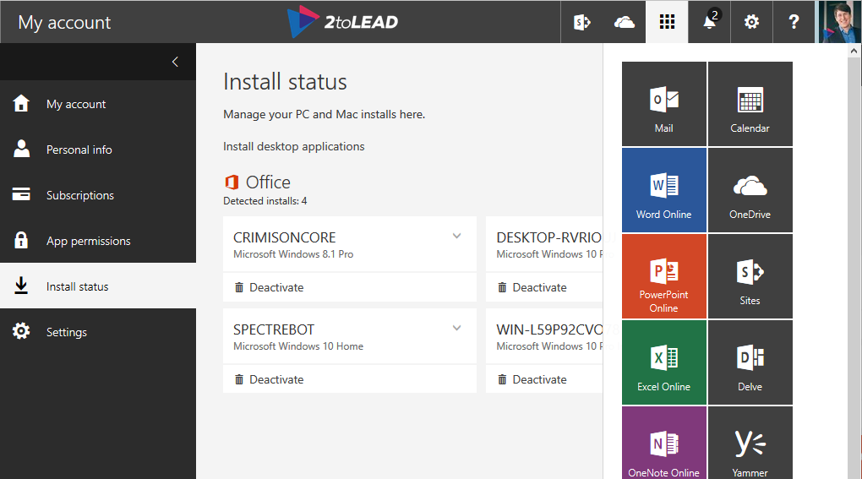
#1. Modern Productivity…
Get the full suite of apps that every modern business should have.
Office always stays up to date, with no cost, work or time required for updates.
Notes:
All the Apps You Love Office 365 Business Premium gives you full, installed Office apps, including Word, Excel, PowerPoint, Outlook, Publisher and OneNote on up to five PCs or Macs. Yes, full versions running on your machines!

Slide 12
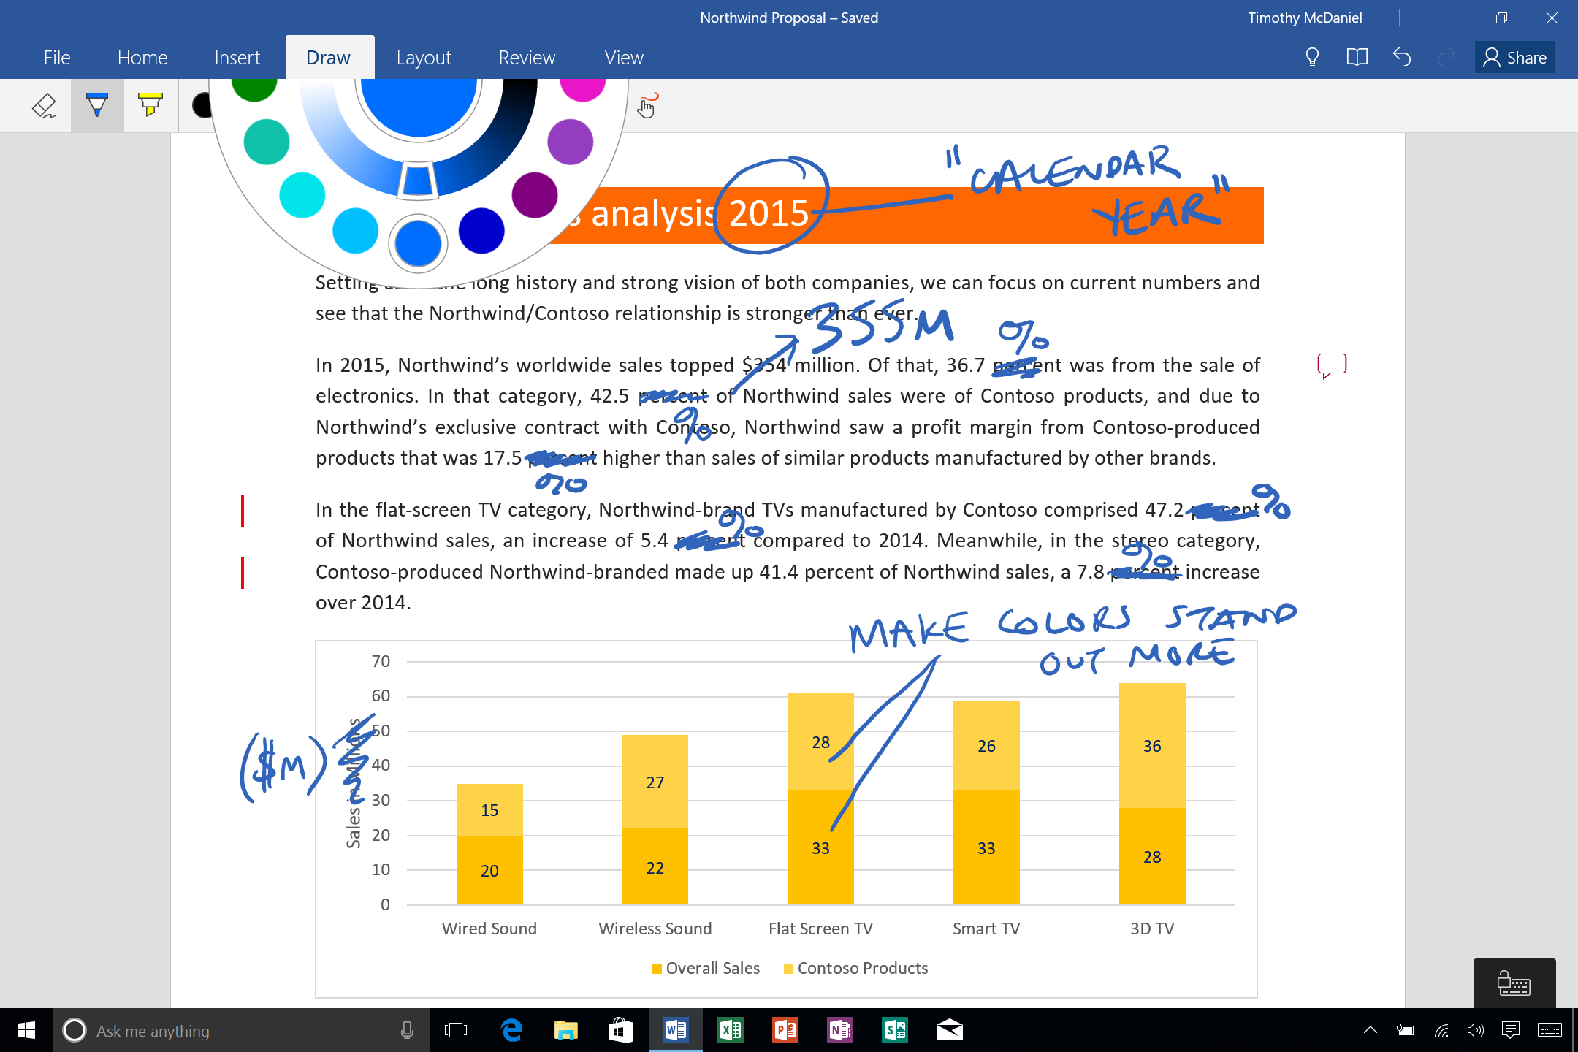
#1. Modern Productivity…
Built to make sure you can still be product when just using touch.

Slide 13
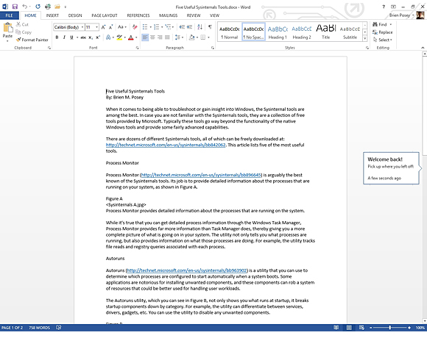
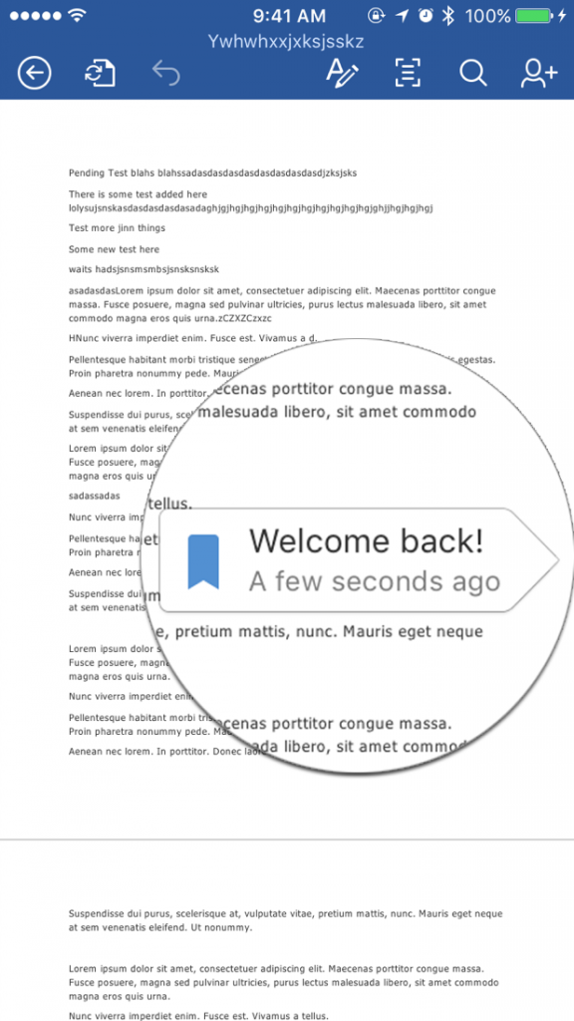
#1. Modern Productivity…
Helping you work even more effectively no matter what device you work from.

Slide 14
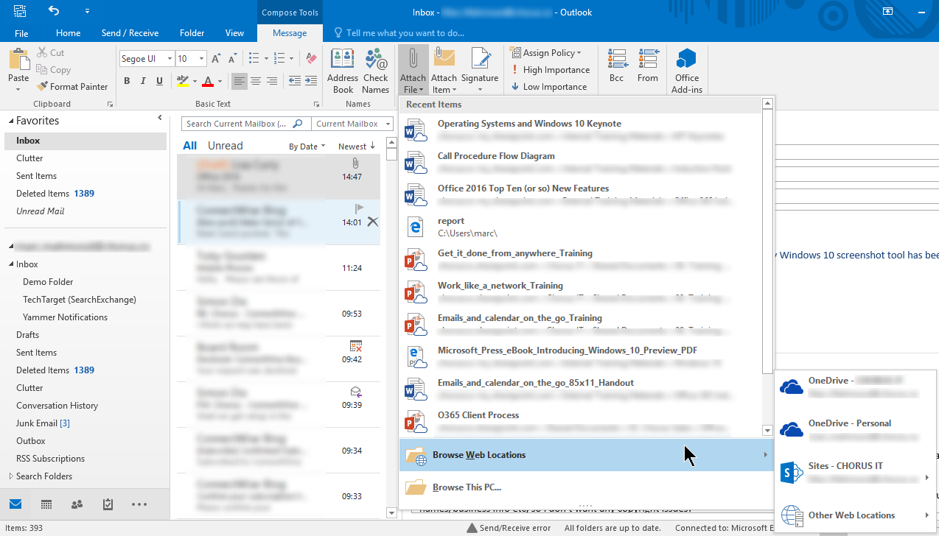
#1. Modern Productivity…
Get powerful capabilities like finding the feature you are looking for faster.
Or sharing a modern attachment from Outlook.
Notes:
Business-class email Tired of unreliable email? You’re going to love your powerful new email, calendar and contacts. Each user receives a 50 GB inbox. Your email will be secure, professional and mobile-friendly.

Slide 15
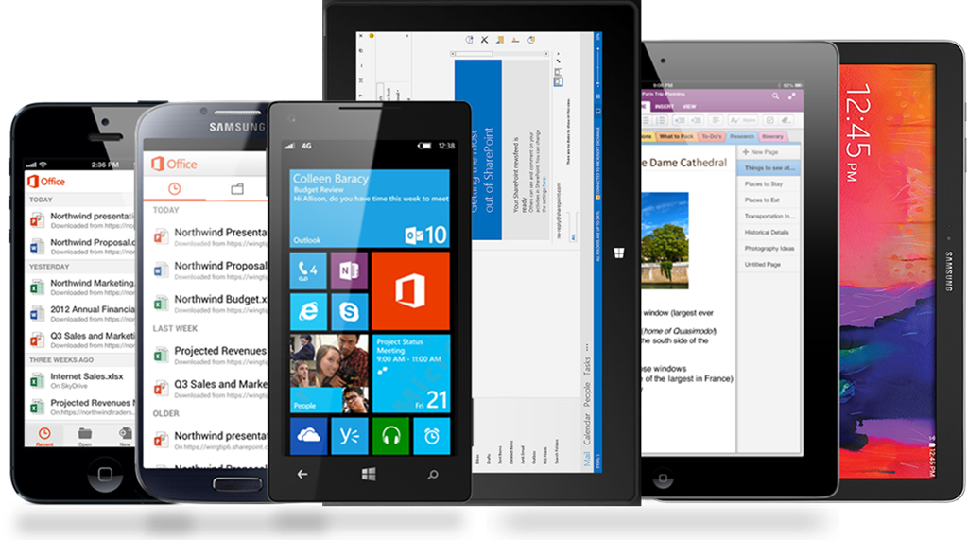
#1. Modern Productivity…
Make yourself more productive when working on mobile devices.
Notes:
Office 365 Mobile Apps Perfect for mobile employees, you get the full installed Office experience with built-in security on up to five tablets or phones, which makes storing, sharing and updating Office docs on the go easy.

Slide 16
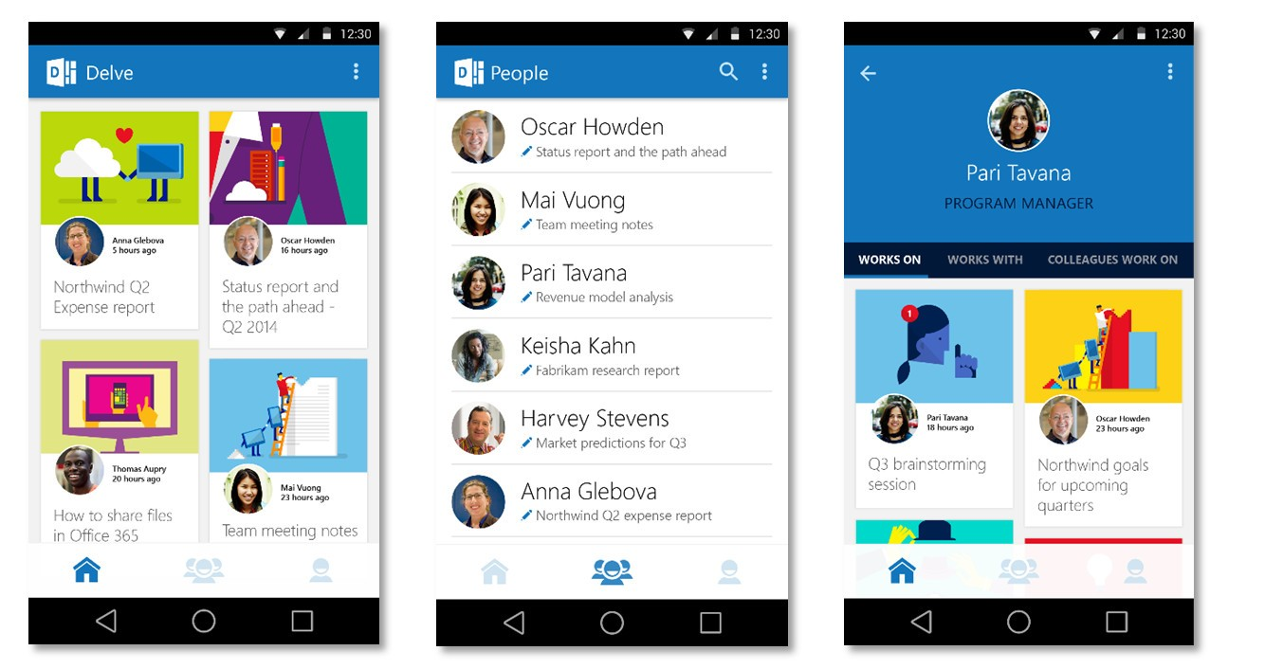
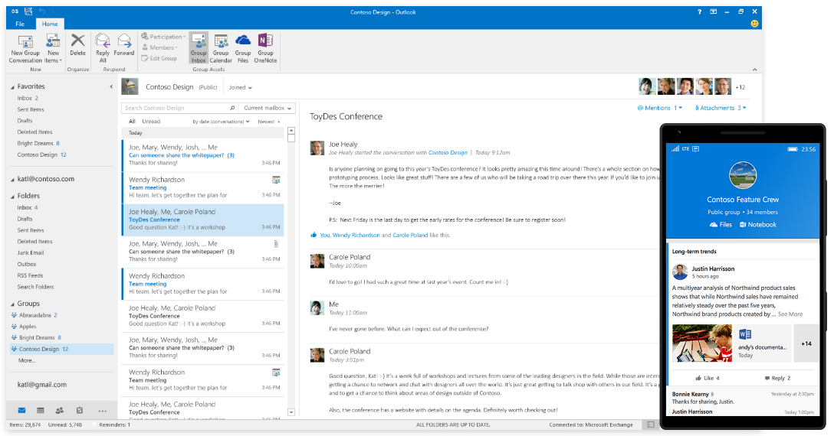
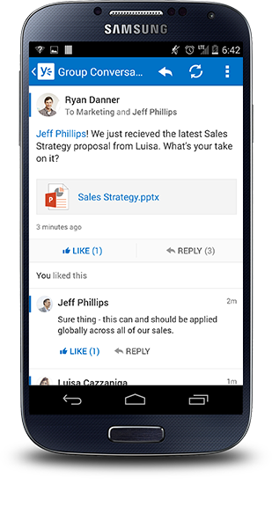
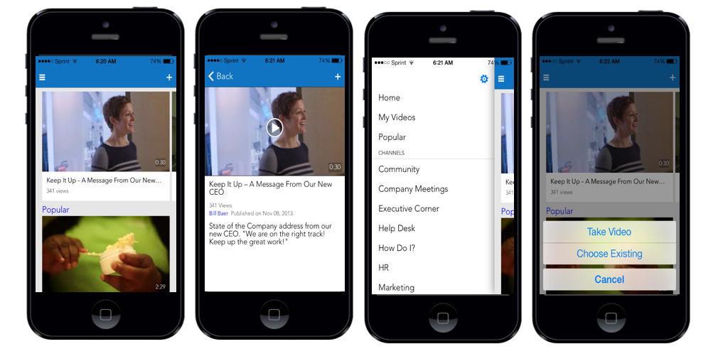
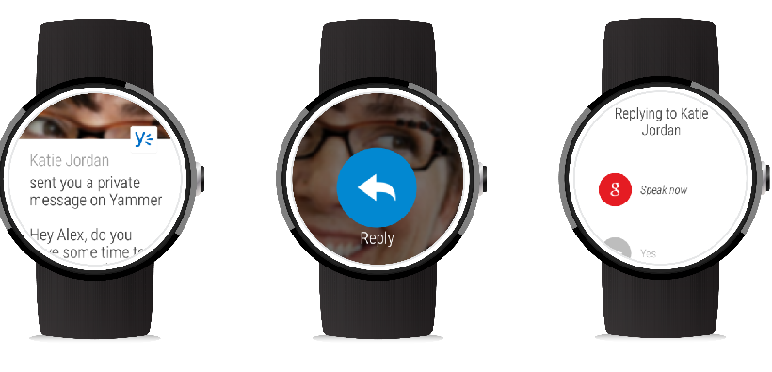
#1. Modern Productivity…
Take advantage of Mobile first experiences when using Yammer, Groups,
Delve, Office Video & more…
Notes:
Office 365 Mobile Apps Perfect for mobile employees, you get the full installed Office experience with built-in security on up to five tablets or phones, which makes storing, sharing and updating Office docs on the go easy.

Slide 17
5 Ways to Run A Virtual Business…
Modern Productivity
Connecting Teams
Great Customer Experiences
Building & Amplifying Your Brand
Outsourcing & Renting

Slide 18
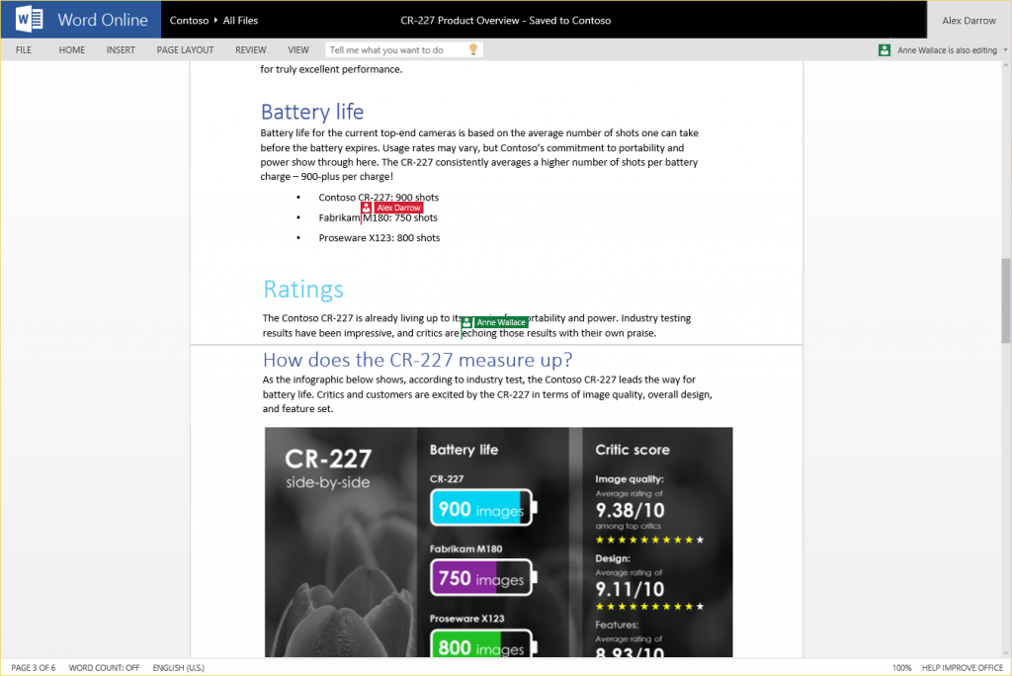
#2. Connecting teams…
Not only can we edit files, but we can even easily edit them with other people.
In the browser, or in the Office client – edit at the same time.
Notes:
Online versions of Office Office 365 comes with Office Online, which allows you to save documents, spreadsheets and presentations online, in OneDrive. Office Online is another simple way to collaborate in the cloud.

Slide 19
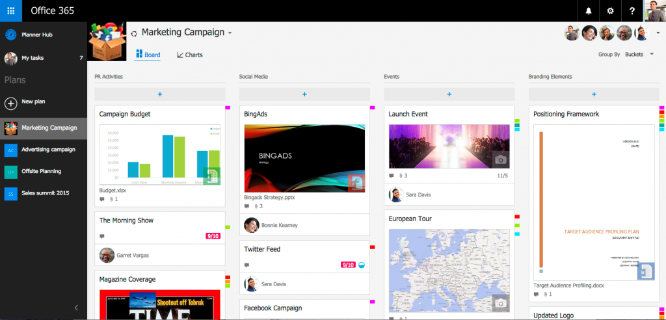
#2. Connecting teams…
Often have email conversations about the status or asking for an update?
Use planner to coordinate better and improve communication with Groups.

Slide 20
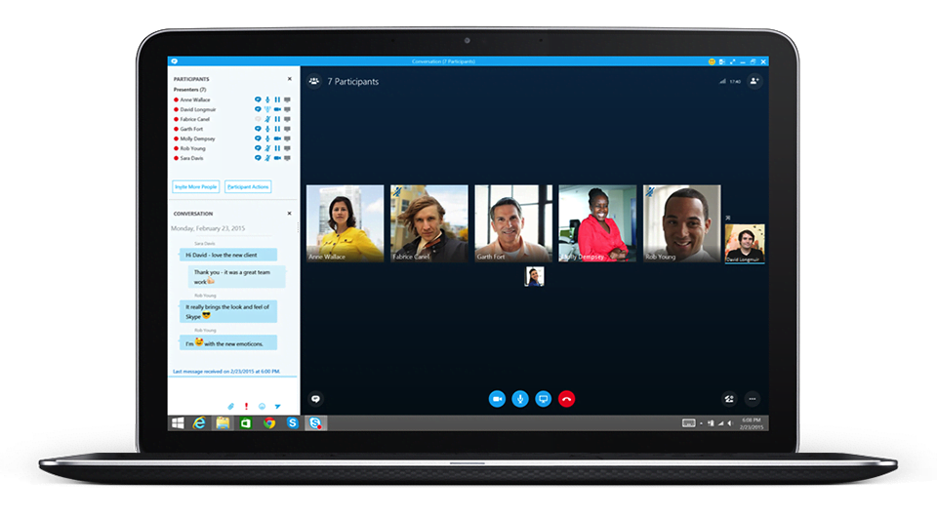
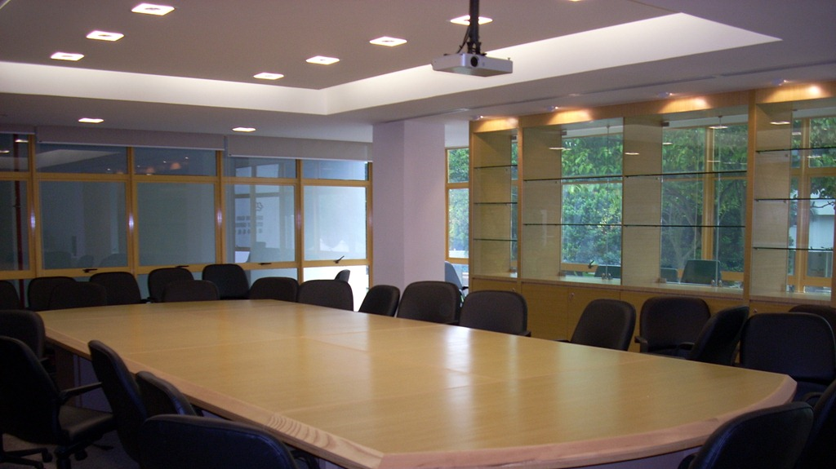
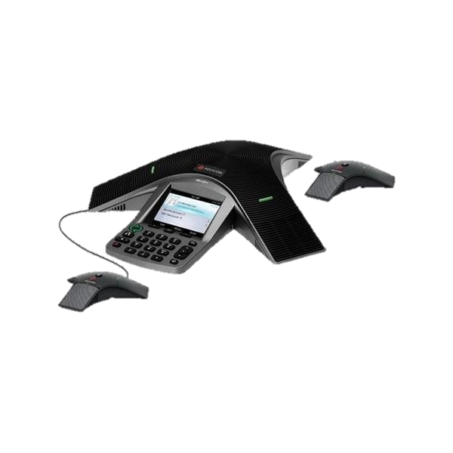
#2. Connecting teams…
The way we manage meetings, and the way we collaborate has changed.
Consider encouraging the use of video to connect more. Or drop in meetings.
Notes:
Year after year voicemail use has dropped 8%, with only 14% of people bothering to listen through the entire voicemail message.
38% of video users report increase of improved retention in meetings that use video instead of just voice. 100% of video users say it helps them accelerate decision making.
From Forrester TEI - Another interviewed organization described a use case that has resulted in millions of dollars in additional revenue: “Opening an office used to take three to four months. Our latest opening, using Office 365, took 18 days. When we get a grant, we can only start to invoice once we begin to perform work. That means we were losing three months of revenue.” This amounted to nearly $200,000 per month for one office, and five offices were being opened in a typical year.

Slide 21
5 Ways to Run A Virtual Business…
Modern Productivity
Connecting Teams
Great Customer Experiences
Building & Amplifying Your Brand
Outsourcing & Renting

Slide 22
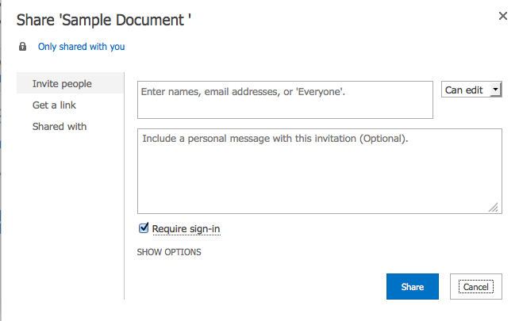
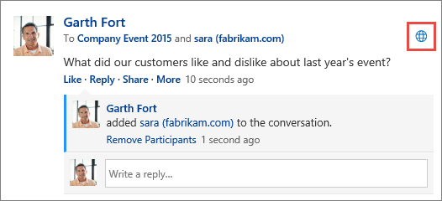
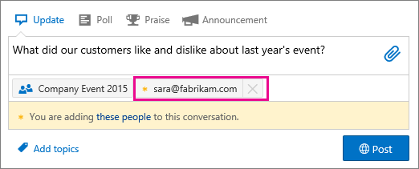
#3. great Customer experiences…
We make it easier than ever to work interactively with customers.

Slide 23
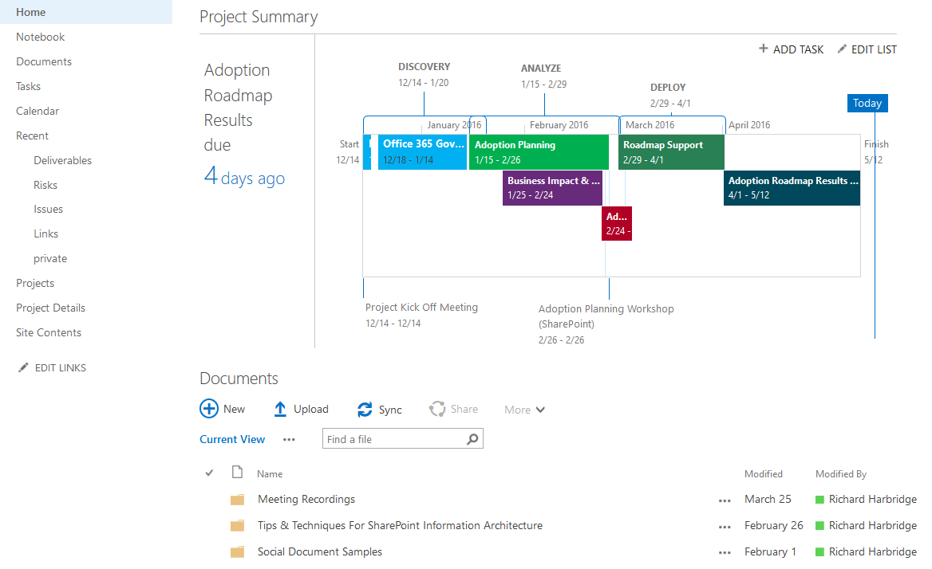
#3. great Customer experiences…
We make it easier than ever to work interactively with customers.

Slide 24
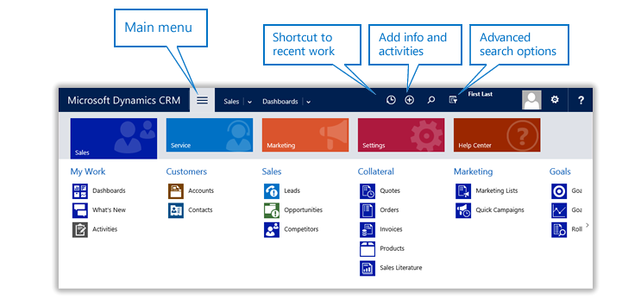
#3. great Customer experiences…
Follow up with customers more rapidly and manage your customer
engagement with an integrated CRM experience.

Slide 25
5 Ways to Run A Virtual Business…
Modern Productivity
Connecting Teams
Great Customer Experiences
Building & Amplifying Your Brand
Outsourcing & Renting

Slide 26
#4. Building & Amplifying Your Brand…
You should have a brand and presence on LinkedIn, Facebook, Twitter and
other relevant social platforms.

Slide 27
#4. Building & Amplifying Your Brand…
Brand all the customer experiences. Email signatures, social profile pictures,
logon experience, Intranet, your documents, presentations and much more.

Slide 28
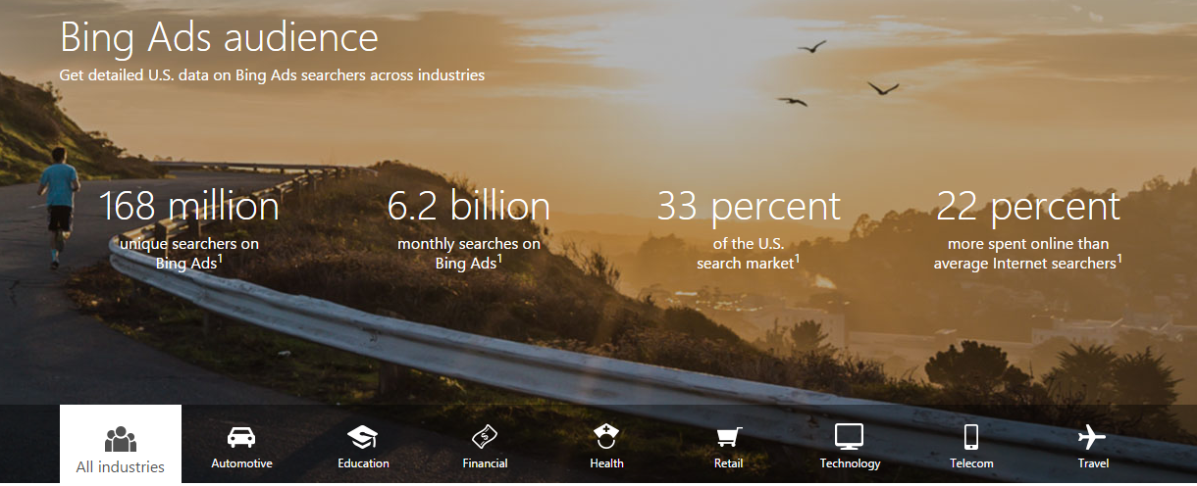
#4. Building & Amplifying Your Brand…
Create a compelling website (GoDaddy) and get more customers
Through the effective use of search marketing with bing advertising.

Slide 29
5 Ways to Run A Virtual Business…
Modern Productivity
Connecting Teams
Great Customer Experiences
Building & Amplifying Your Brand
Outsourcing & Renting

Slide 30
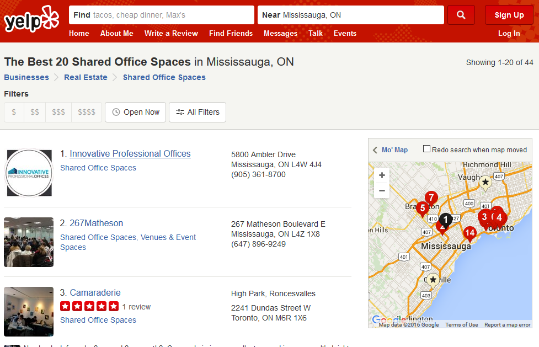
#5. Outsourcing & Renting…
Shared spaces can be a great way to reduce costs while enabling you to get
a boardroom or meeting space when you need it (instead of your dining room).

Slide 31
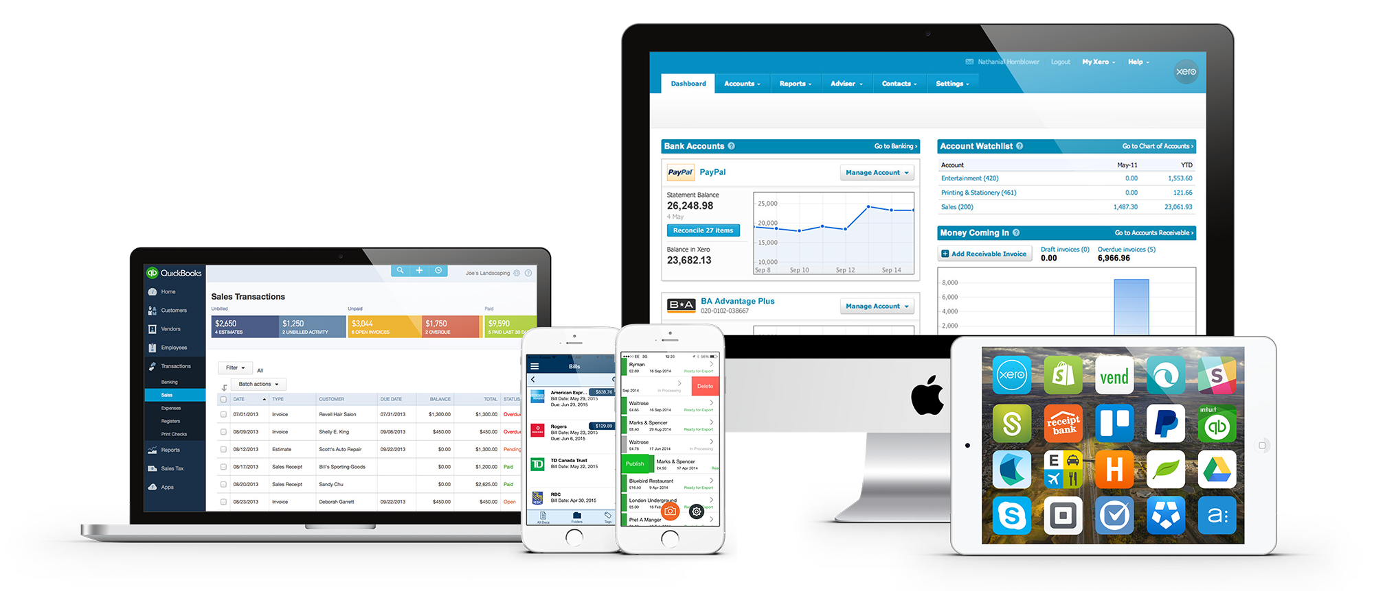
#5. Outsourcing & Renting…
Consider outsourcing accounting and appropriate management tasks.

Slide 32
Get A New Technology Plan…
Struggling on where to start? Work with us to cut costs and boost productivity.
We can help you plan how to transform and improve your business.
Notes:
If the idea of modernizing your business intrigues you, but you’re not sure where to start, your best bet is to work with a Microsoft Certified Partner to develop a plan unique to your needs and wants. If you already have a partner, simply ask them to put forward a proposal to cut costs and boost productivity. If you don’t have a partner already, we can help you find one today.

Slide 33
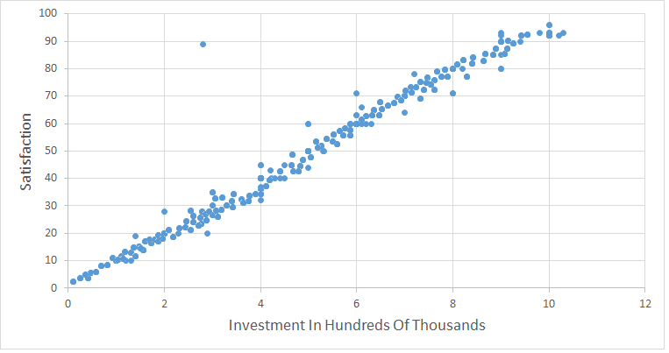
Your Organization Can be better than average…
Let’s drive ourselves and our businesses to be better.

Slide 34
Thank You!
Organizers, Sponsors and You for making this possible.
thomasrayner.ca
microsoftsavesyoumoney.ca
emug.ca
Message Me On LinkedIn or Twitter
Follow me: @MrThomasRayner, workingsysadmin.com, linkedin.com/in/thomasrayner

